Slide 1
Scheme Dream: A Sleek and Powerful Scheme Interpreter
Lewis University SP23-CPSC-46000-LT1-Programming Languages
Term Project Final

Slide 2
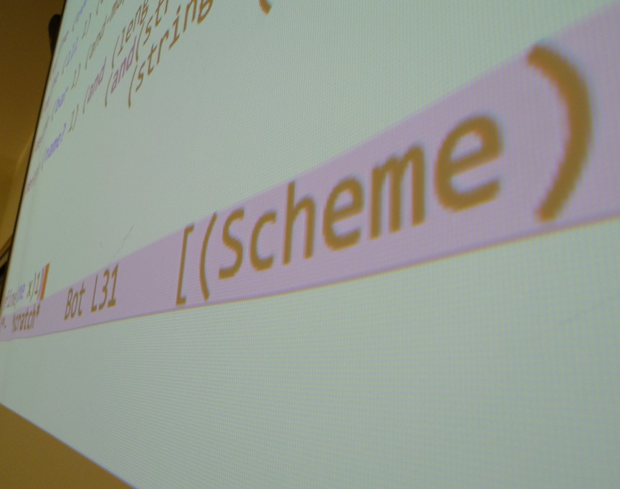
Introduction
Expressions and Environments
Built-in Functions and Procedures
Tail Call Optimization
Helper Functions and Modules
Conclusion
This Photo by Unknown Author is licensed under CC BY

Slide 3
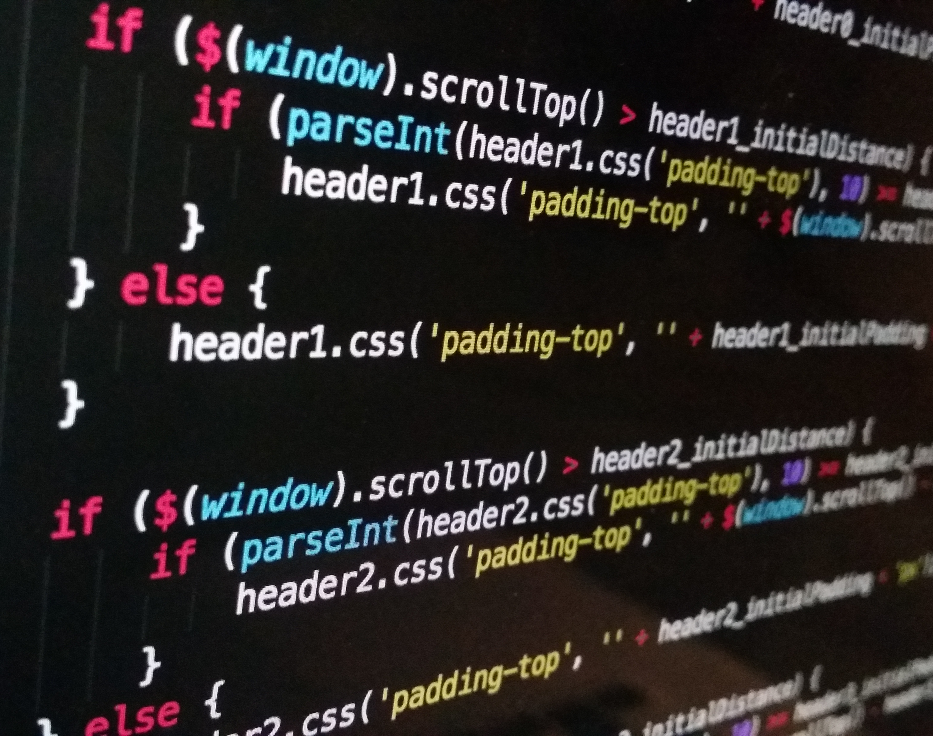
Introduction
Scheme is a dialect of Lisp that is known for its minimalist syntax and powerful functional programming features. This code implements an interpreter for the Scheme programming language using Python. The interpreter uses several helper functions and modules to parse Scheme code, evaluate expressions, and manage environments. It recursively evaluates expressions in each environment and supports built-in functions and procedures for basic operations like arithmetic and list manipulation.

Slide 4
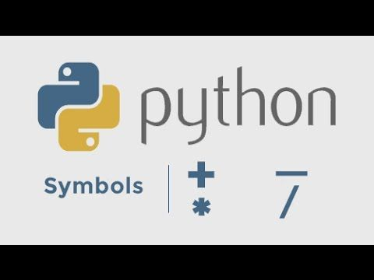
Expressions and Environments
Expressions in Scheme can be atoms, such as numbers or symbols, or they can be lists of expressions, such as function applications. The interpreter uses a few special forms, such as 'define' and 'lambda', to define functions and bind values to symbols in the environment.
Environments are used to keep track of variables and their values as the interpreter evaluates expressions. The interpreter uses a global environment and creates new environments for each function call or let expression.

Slide 5
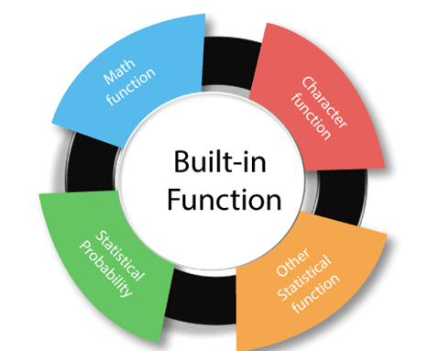
Built-in Functions and Procedures
The interpreter supports built-in functions and procedures for basic operations like arithmetic and list manipulation. These include addition, subtraction, multiplication, division, cons, car, cdr, and more.
The interpreter also supports higher-order functions, such as map, filter, and reduce, which take a function and one or more lists as arguments and apply the function to the elements of the lists.

Slide 6
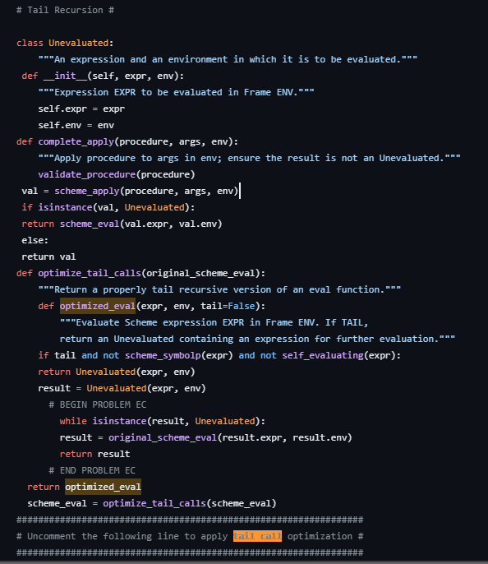
Tail Call Optimization
One notable feature of this interpreter is its support for tail call optimization. This is a technique that can be used to optimize certain kinds of recursive functions so that they use constant stack space.
Tail call optimization works by replacing a function call with a jump to the beginning of the function, thus avoiding the creation of a new stack frame. This can significantly improve the performance of recursive functions.

Slide 7
Helper Functions and Modules
The interpreter uses several helper functions and modules to parse Scheme code, evaluate expressions, and manage environments. These include a tokenizer, a parser, an evaluator, and an environment manager.
The tokenizer splits the input code into tokens, which are then parsed by the parser into expressions. The evaluator recursively evaluates the expressions and returns their values, while the environment manager handles the creation and management of environments.

Slide 8

Conclusion
In conclusion, this code implements an interpreter for the Scheme programming language using Python. The interpreter supports expressions, environments, built-in functions and procedures, and tail call optimization.
It also uses several helper functions and modules to parse Scheme code, evaluate expressions, and manage environments. Overall, this interpreter provides a powerful tool for working with Scheme code and exploring the world of functional programming.

